Slide 1

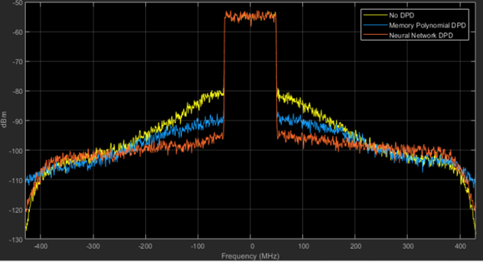
Correction of Non-linear Distortions in Power Amplifiers Using Neural Networks
Guidance: Dr. Nimrod Ginzburg
Avishay Spitzer | Uriel Shaowat

Slide 2

Motivation and Background
Modern communication systems utilize amplifiers for transmitting signals through the channel
Amplifiers introduce distortions to the signal
Non-linear distortions
Time dependent distortions
There is an extensive industry focused around correction of the signal

Slide 3
Goal
Use Neural Networks advantages for signal correction
Utilize Transfer learning

Slide 4
Methodology
Lab includes:
Signal generator
Scope analyzer
Environment for emulating the Neural Network
The signal generated is mutated for accounting the distortions, based on the Neural Network output

Slide 5
Completed Tasks
Background research:
Neural Networks fundamentals
Digital pre-distortion base concepts
Lab installation

Slide 6
Next Steps
Hands-on experience with traditional DPD
Implying various flavors of NNs
Research different well trained existing models capabilities under transfer learning for DPD

